Slide 1
Layout: Top Sales / Service Leads
Calvin
2013.03.15

Slide 2
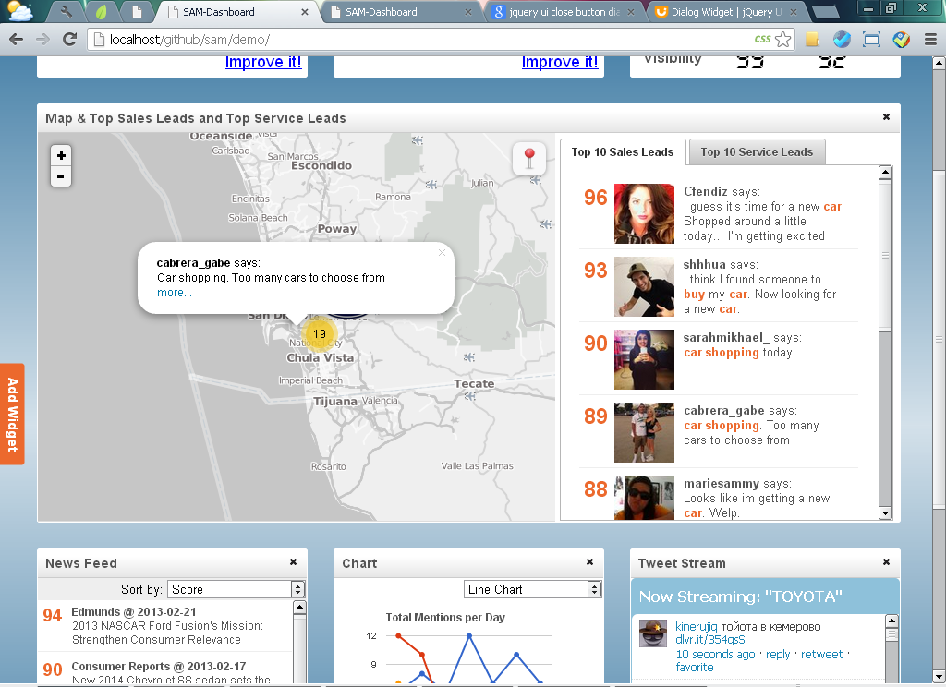
<div id='widget_map' ……… >
<div style='height: 98%; width: 100%;'>
<! --map -->
<div id='map' style=' width:60%; height:95%; float:left'></div>
<!– leads tabs-->
<div id='leads' style='width:38.5%; height:95%; padding:5px; float:left' class='tabs'>
<ul>
<li><a href='#sales_leads'>Top 10 Sales Leads</a></li>
<li><a href='#service_leads'>Top 10 Service Leads</a></li>
</ul>
<div id='sales_leads' class='leads' style='height: 350px; overflow:auto; background-color: ;'> Sales Leads </div>
<div id='service_leads' class='leads' style='height: 350px; overflow:auto; background-color: ;'> Service Leads </div>
</div>
</div>

Slide 3
<li id=‘{i}’ leadType=‘{k}'>
<div class='score'> + lead.score + </div>
<div class='content'>
<img title='see more about the lead' src='" + userData[lead.user].image_url + "' />
<div>
<label class='title'>" + lead.user +"</label> says:<br>" + pathgeo.util.highlightKeyword(app.constants.KEYWORDS, lead.text, true) + </div> </div>
</li>
Use CSS classes (e.g. score and content) to control the layout

Slide 4
/** score and content */
.score {width:5%; text-align:center; margin-right:9px; font-weight:bold; color:#EC692D; font-size:150%; }
.content {width:86%; color:#555555; padding-left:10px; font-size:90%;}
.content .title {font-weight:bold;}
/** sales_leads */
#leads > div ul {padding:0px; margin:0px; list-style:none;}
#leads > div ul li {border-bottom:1px solid #eeeeee; padding:5px;display: inline-block; width:96%;}
#leads > div ul li:hover {background-color:#eeeeee;}
#leads > div ul li div {float:left;}
#leads > div ul li .score {font-size:170%;}
#leads > div ul li div img {width:65px; height:65px; float:left; cursor:pointer;}
#leads > div ul li div div {float:left; width:70%;padding-left:10px;}
// Make the layout of “score” and “content” div horizontally and align to left
// Make the layout in the “content” div (i.e. image and its div) horizontally and align to left

